Slide 1
Neural retrieval model - Document ranking
Arno Deceuninck
Notes:
I have chosen the second project: Document ranking with a Neural retrieval model.

Slide 2
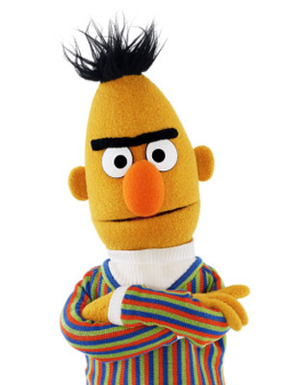
BERT
Transformer-based
Neural network model
Sentence-transformers Python library
Notes:
As recommended in the assignment, I used BERT for the semantic analysis of the documents. BERT is a Transformer-based Neural network model. More specifically, I used the sentence-transformers Python library, which provided an easy interface to use and refine some pretrained models.

Slide 3
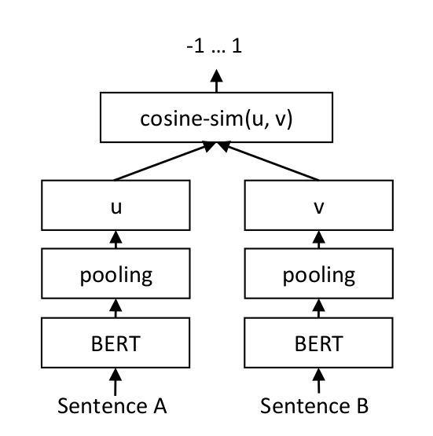
Architecture
Word token to vector
Pool vectors of document
Compare
Notes:
This is an overview of the basic architecture of SBERT. A sentences gets split into word tokens and those get converted to vectors with BERT. Those vectors representing the document then get pooled, to get one vector representing the entire document, e.g. by taking the mean. This way, for a sentence A we get the vector u. Once we have some vectors like this, we can compare them to each other, for example by taking the cosine-similarity of them to see how closely related their semantic meaning is.

Slide 4
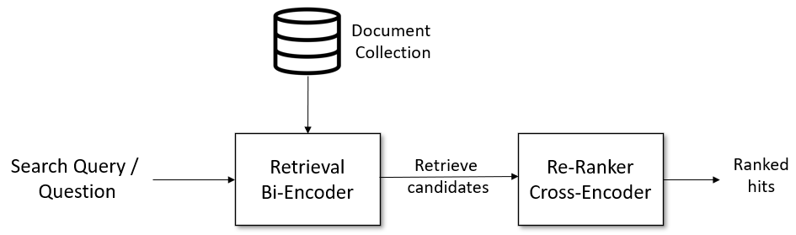
Notes:
We use two different kind of Encoders: A Bi-Encoder and a Cross-Encoder. When we get a new search query, we first retrieve a few candidates with the Bi-Encoder (e.g. 100) and then re-rank them using the cross-encoder to generate a ranked hit list.

Slide 5
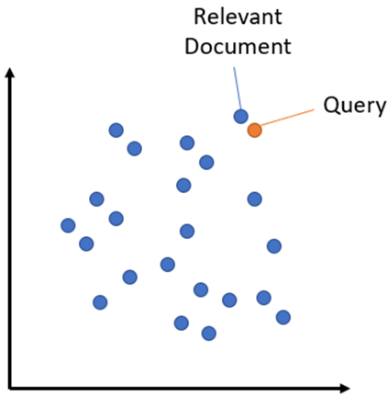
Bi-Encoder
Embed all documents
Embed query
Retrieve candidate set
Notes:
The bi-encoder first indexes all documents by mapping them to a vector. When we get a new query, we first map this to the same vector space and then select some nearby documents (represented by a vector) to retrieve a candidate set. The advantage of this is that it is fast, but it’s not always accurate, so we use a Cross-Encoder to improve those results by reranking them.

Slide 6
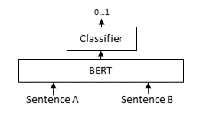
Cross-Encoder
Re-Ranker
Pairwise comparison
Relevance score 0…1
Notes:
A Cross-Encoder does pairwise comparisons between the query and the selected candidate documents. For each document, this returns a relevance score between 0 and 1. The documents with the highest score are predicted to be the most relevant for the user, so they get shown first in our ranked list.

Slide 7

Pretrained models
MSMARCO
500k queries from Bing search
Bi-Encoder
msmarco-bert-base-dot-v5
Cross-Encoder
cross-encoder/ms-marco-TinyBERT-L-2-v2
Notes:
As mentioned in earlier presentations, SBERT contains a lot of pretrained models you can use. MSMarco seemed the most relevant for our use case. It is based on 500 thousand queries from the Bing Search engine, but Robbe mentioned in his presentation that it didn’t perform well for them, so I might also have to try some other datasets.

Slide 8
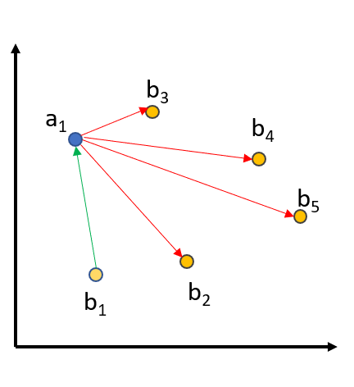
Fine-tune model
Provided labels
Notes:
Those pretained models can still be improved. Since we have a large set containing labels, we can use those to fine tune the chosen model.

Slide 9
Model Scores
BiCrossRetriever worse than expected
LuceneRetriever still best
LuceneCrossRetriever: combination
Name | Recall@10 | Precision@10
LuceneRetriever | 0.49958 | 0.49642
BiCrossRetriever | 0.25137 | 0.30258
LuceneCrossRetriever | 0.43721 | 0.43416

Slide 10
CrossEncoder selection
Name | Recall@10 | precision@10 | Time
LuceneRetriever | 0.49958 | 0.49642 | 431.44it/s
BiCrossRetriever (MsMarco) | 0.24137 | 0.30258 | 1.62it/s
LuceneCrossRetriever (MsMarco-TinyBERT) | 0.43721 | 0.43416 | 6.72it/s
LuceneCrossRetriever (MsMarco-MiniLM) | 0.45076 | 0.44782 | 1.08s/it
LuceneCrossRetriever (QNLI) | 0.36328 | 0.36055 | 3.20s/it
LuceneCrossRetriever (STSB-TinyBERT) | 0.33324 | 0.33090 | 3.09it/s

Slide 11
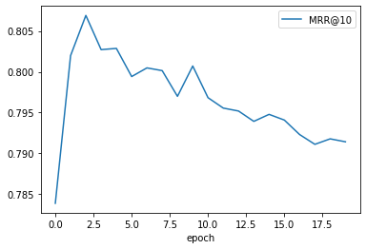
Epochs
CERerankingEvaluator
Epochs: 2 or 4?

Slide 12
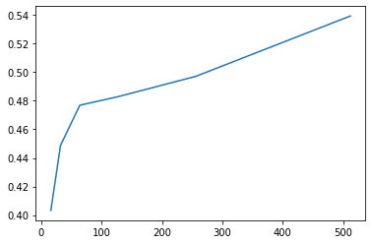
Truncate Length
No Max Specified
512 same as None

Slide 13
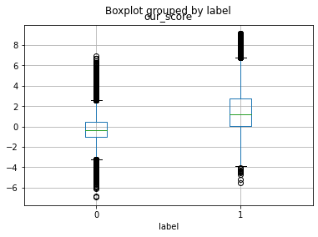
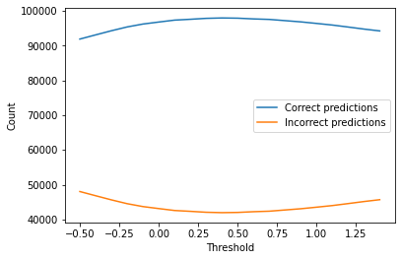
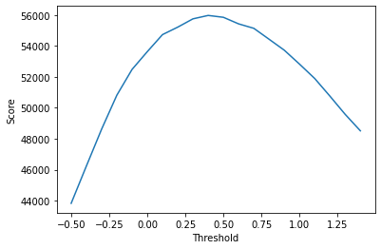
Relevant Threshold

Slide 14

Other parameters
Train batch size
Warmup size
…

Slide 15
Final Results - Recommending
Name | Recall@10 | Precision@10
LuceneRetriever | 0.49958 | 0.49642
Optimized LuceneCrossRetriever | 0.54272 | 0.53928
Improvement | 0.04314 | 0.04286

Slide 16
Final Results - Labelling
Warning: Those results might not be representative
Name | Recall | Precision
LuceneRetriever | UNKNOWN | 0.49721
Optimized LuceneCrossRetriever | 0.59636 | 0.68022
Improvement | UNKNOWN | 0.18301

Slide 17



